Slide 1


AUDIT BASED APPLICATION NETWORK CONFIGURATION SECURITY
ANALYZER
Using CIS Benchmarks | PG-DITISS Project
Batch: Aug 2025 – Feb 2026
SUBMITTED BY
GUIDED BY
Bhavana Madarse
Dheeraj Sadawarte
Katru Tirumala Venkat
Himanshu Barfa
Amit Yadav

Slide 2


INTRODUCTION
Network security is foundational to any organization. However, securing the configuration of network devices (Routers, Switches) is often overlooked.
This Project:
•
Is a web-based audit tool.
•
Focuses on Cisco IOS devices.
•
Automates the validation of configurations against global CIS Benchmarks.

Slide 3




PROBLEM STATEMENT
▹
SECURITY VULNERABILITIES
Network devices often ship with default or insecure configurations that leave organizations exposed to cyber threats.
▹
MANUAL INEFFICIENCY
Traditional manual audits are time-consuming, repetitive, and highly prone to human error, leading to inconsistent results.
▹
EXPERTISE GAP
Validating against complex CIS Benchmarks requires specialized knowledge that may not be available across all teams.

Slide 4








PROJECT OBJECTIVES
AUTOMATE AUDITS
VALIDATE STANDARDS
GENERATE REPORTS
REDUCE RISK
Eliminate manual checks by automating the security auditing process for network configurations.
Minimize human error and enhance overall network security posture through standardized checking.
Strictly validate Cisco device configurations against industry-standard CIS Benchmarks.
Produce detailed, structured audit reports (HTML/CSV) identifying compliant and non-compliant controls.

Slide 5


SCOPE & TECHNOLOGIES
PROJECT SCOPE
TECHNOLOGIES USED
▹
Configuration Auditing: Focus on offline analysis of config files.
▹
Backend Processing: Python for robust parsing and logic handling.
▹
Device Support: Targeted specifically for Cisco Routers and Switches.
▹
Web Interface: Flask framework for a user-friendly upload and report interface.
▹
Standard: Uses Center for Internet Security (CIS) Benchmarks as the single source of truth.
▹
Rule Engine: Regex and block-based logic using JSON-defined CIS rules.
▹
Reporting: HTML5 for interactive dashboards and CSV for raw data export.
▹
Analysis Type: Static analysis of configuration dumps, ensuring zero impact on live production networks during audit.

Slide 6







TECHNOLOGY STACK
PYTHON 3
FLASK
HTML5 / CSS3
JSON & REGEX
Core backend logic for file parsing and regex matching.
Lightweight web framework to serve the UI and handle uploads.
Responsive frontend for the dashboard and reports.
JSON for storing rules and Regex for pattern matching.

Slide 7
METHODOLOGY
COLLECT
DEFINE
PARSE
COMPARE
REPORT
Gather CIS security guidelines
Translate rules into JSON format
Normalize device config files
Evaluate against benchmark rules
Generate compliance artifacts

Slide 8
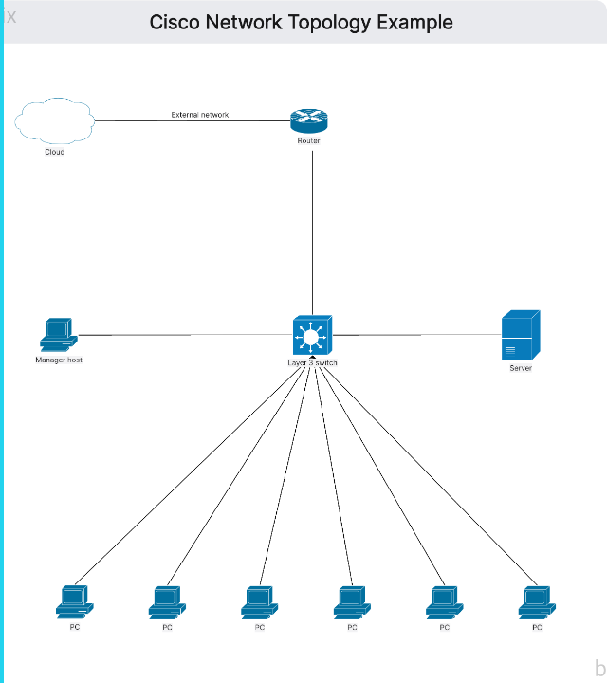
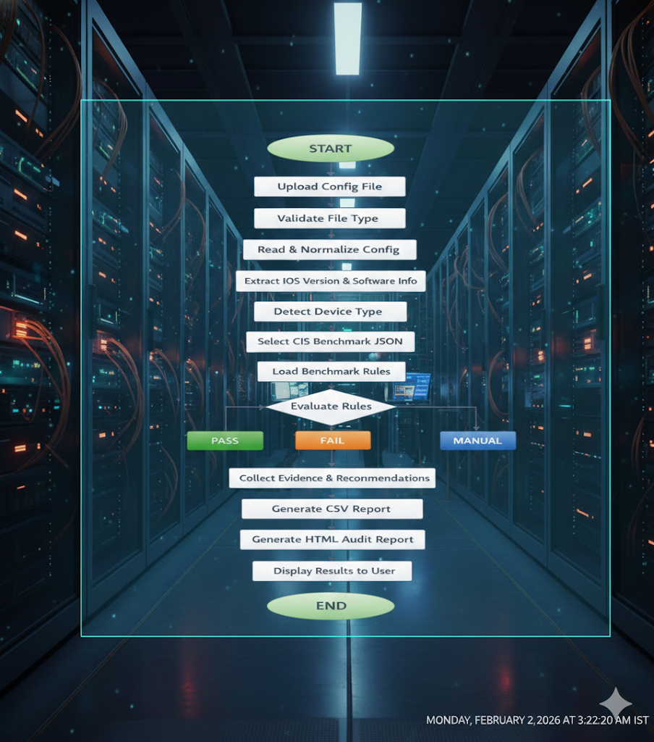
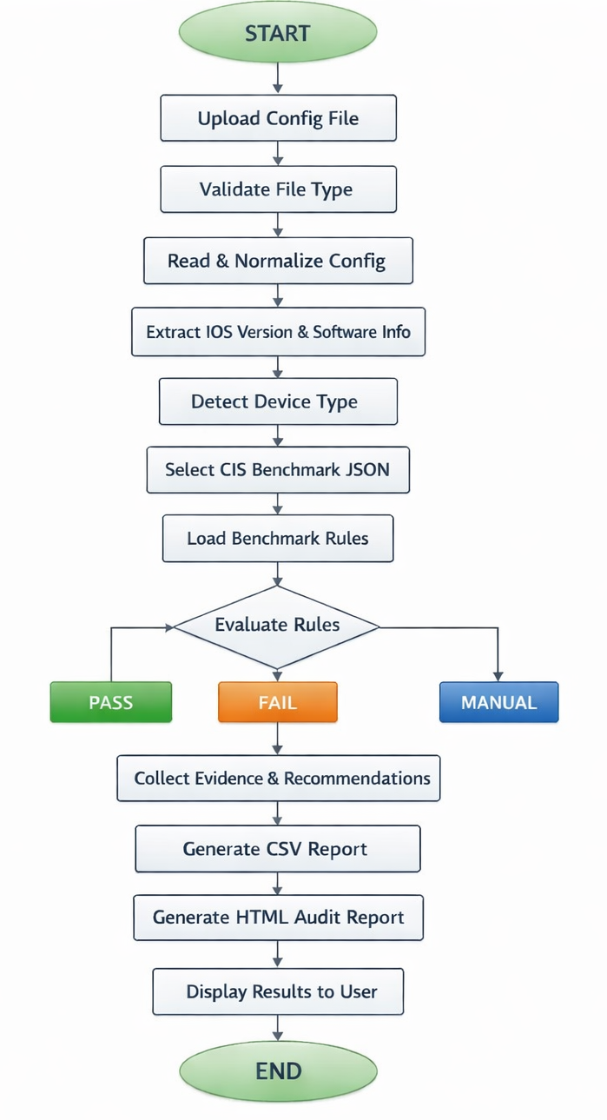
SYSTEM FLOW
Upload & Validate Config File
Detect Device & Version
Load JSON Benchmark Rules
Evaluate Rules (Pass/Fail)
Generate CSV & HTML Reports
The system follows a linear pipeline from data ingestion to report generation, ensuring data integrity at every step.

Slide 9


SYSTEM ARCHITECTURE
CORE COMPONENTS
Input Handler: Validates .txt/.cfg files.
Parser Engine: Normalizes Cisco IOS syntax.
Evaluator: Compares config against JSON rules.
Reporter: Compiles results into HTML.

Slide 10
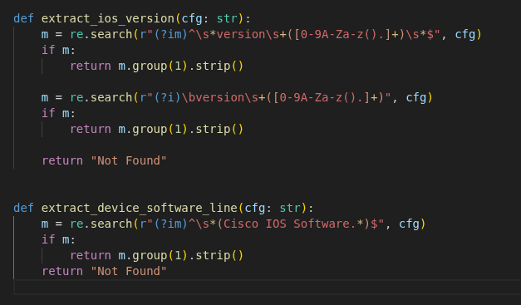
CODE: DEVICE & VERSION DETECTION
Before applying rules, the system must identify the device. We use specific Regex patterns to parse the `show version` header.
def
detect_device_metadata
Logic Flow:
if
return
1.
Read the first 50 lines of the file.
"type"
"Router"
"version"
"confidence"
2.
Search for "Cisco IOS" keywords.
"High"
return
"type"
"Unknown"
"confidence"
"Low"
3.
Extract version number using capture groups.

Slide 11
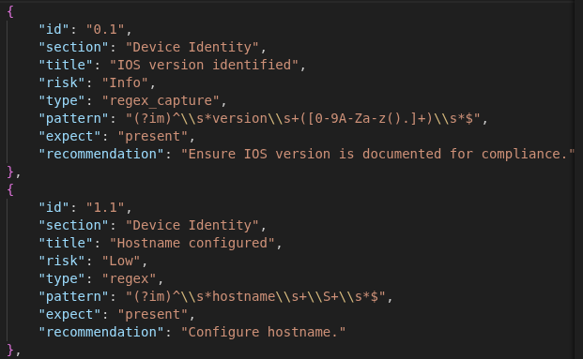
CODE: JSON RULE STRUCTURE
JSON: CISCO_ROUTER_BENCHMARK.JSON
We decoupled the rules from the code. The JSON Model acts as a flexible database.
"id"
"1.1.1"
"section"
"1. Initial Setup"
"title"
"Ensure 'service password-encryption' is set"
"description"
•
Decoupling: Adding a new CIS benchmark doesn't require changing Python code, just adding a JSON file.
"Prevents passwords from being visible in clear text."
"regex_pattern"
"^service password-encryption"
"risk_level"
"High"
"Run command: service password-encryption"
"remediation"
•
Regex Field: Stores the exact pattern used for validation.
•
Remediation: Stores instructions shown to the user if the check fails.

Slide 12
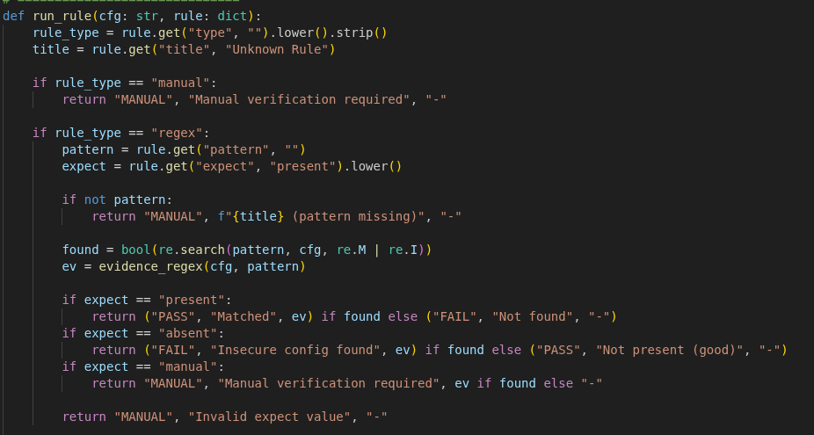

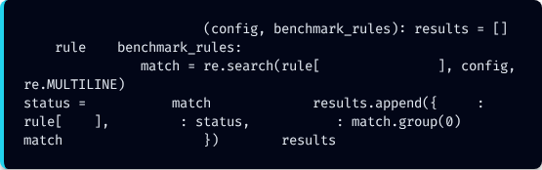
CODE: THE EVALUATION ENGINE
This loop is the "brain" of the application. It iterates through every rule in the loaded benchmark against the configuration file.
PYTHON: AUDIT_ENGINE.PY
Performance Note:
Using re.MULTILINE allows us to match patterns
that span across line breaks or are anchored to
the start of a line.
def
evaluate_compliance
for
# Apply the regex pattern to the config content
in
'regex_pattern'
# Determine status based on match existence
"PASS"
if
else
"FAIL"
"id"
'id'
"status"
"evidence"
if
else
"Not Found"
return

Slide 13
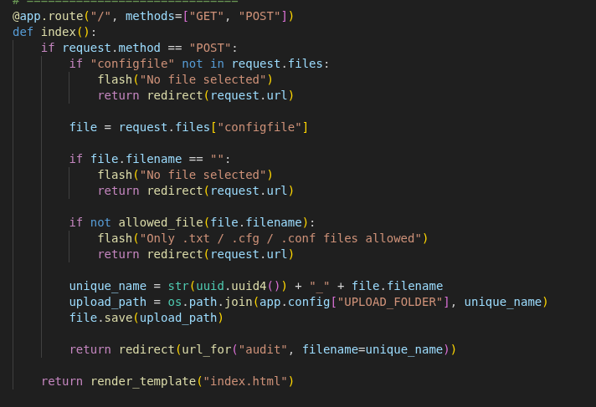
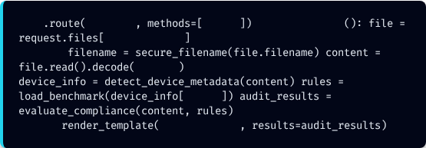
CODE: FLASK ROUTE HANDLER
This section of the code handles the initial user interaction and ensures that only valid configuration files enter the system.
Key Functionalities:
File Upload Management: Processes incoming POST requests and validates that a file has been selected by the user.
Security Filtering: Restricts uploads to specific extensions—.txt, .cfg, and .conf—to prevent unauthorized file types.
Unique File Identification: Generates a UUID-based filename for every upload to prevent data overwriting and maintain a clear audit trail.
Automated Redirection: Once the file is successfully saved to the server, it automatically triggers the audit route to begin the security scan.
PYTHON: APP.PY
@app
'/audit'
'POST'
def
audit_file
# 1. Secure the filename & read content
'config_file'
'utf-8'
# 2. Run the logic pipeline
'type'
# 3. Render the HTML report
return
'report.html'

Slide 14
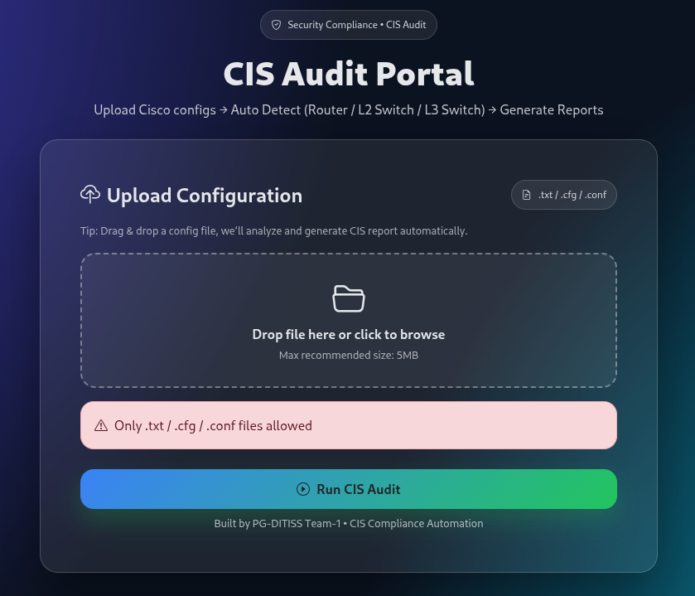



USER-FRIENDLY INTERFACE
▹
DRAG & DROP SIMPLICITY
The modern web interface allows users to easily drag and drop configuration files directly into the analyzer.
▹
AUTOMATIC VALIDATION
The system instantly validates file extensions (.txt, .cfg, .conf) before processing to ensure compatibility.
Paste Your "Upload Configuration" Screenshot Here
(Replace this block with your Screenshot #4)
▹
ONE-CLICK AUDIT
Simply clicking "Run CIS Audit" triggers the entire backend pipeline, making it accessible even to non-experts.

Slide 15
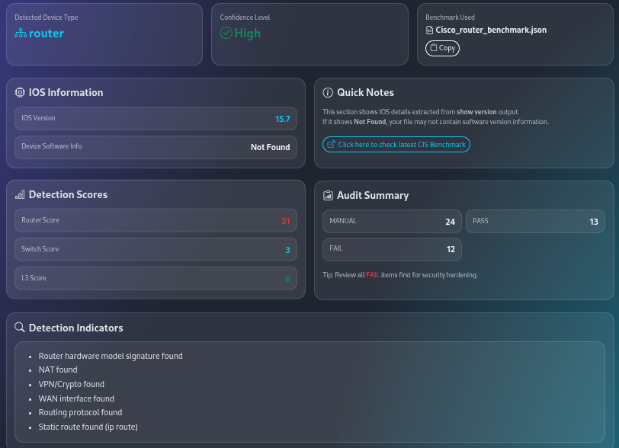



AUTOMATED DETECTION & DASHBOARD
▹
INTELLIGENT IDENTIFICATION
The system parses the config header to automatically detect the device type (e.g., "Router") and IOS version (e.g., "15.7").
▹
CONFIDENCE SCORING
A "High Confidence" indicator confirms that the correct CIS Benchmark rule set has been selected for the analysis.
Paste Your "Audit Results Dashboard" Screenshot Here
(Replace this block with your Screenshot #3)
▹
IMMEDIATE INSIGHTS
The dashboard provides an instant summary of "Pass", "Fail", and "Manual" checks, giving a clear snapshot of compliance posture.

Slide 16
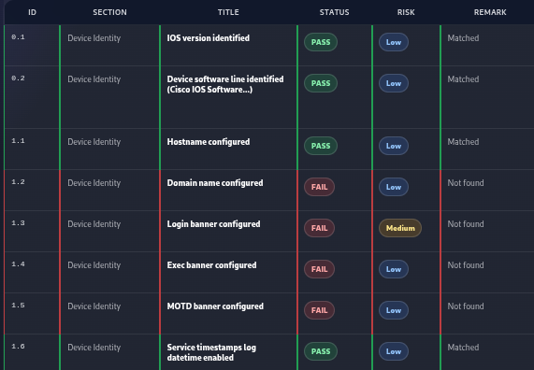

DETAILED AUDIT FINDINGS
▹
GRANULAR ANALYSIS
Every CIS control is listed with its specific ID, Section, and Title, providing a comprehensive audit trail.
▹
EVIDENCE EXTRACTION
Unlike basic tools, this report extracts and displays the exact lines of configuration code that triggered a "Pass" or "Fail".
Paste Your "Detailed Report" Screenshot Here
(Replace this block with your Screenshot #1)
▹
ACTIONABLE REMARKS
Status indicators (Pass/Fail) and risk levels (Low/Medium/High) help auditors prioritize remediation efforts immediately.

Slide 17
DEEP DIVE: VULNERABILITY FINDINGS
ID | Control Name | Status | Risk | Implication
1.2 | Domain Name Configured |  | Low | Lack of domain name affects SSH key generation.
1.3 | Login Banner Configured |  |  | No legal warning for unauthorized access.
1.1 | Hostname Configured |  | Low | Device is correctly identified as R6.

Slide 18
KEY FEATURES
Automatic Detection Intelligently identifies device type (Router/Switch) and IOS version to apply the correct rule set.
Evidence-Based Doesn't just say "Fail"; provides specific lines from the configuration file as evidence of non-compliance.
Risk Classification Categorizes findings to help prioritize remediation efforts based on severity.
Modular Design Decoupled rule engine allows for easy updates to CIS Benchmarks without rewriting the core application logic.

Slide 19
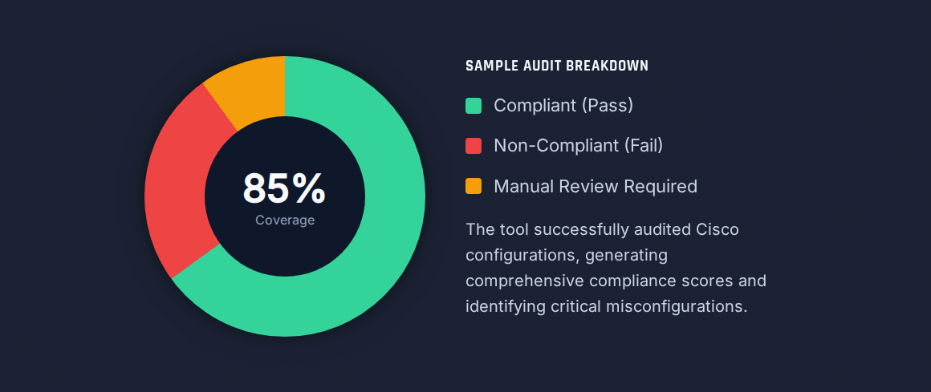
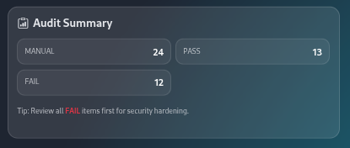
RESULTS & ANALYSIS

Slide 20


LIMITATIONS & FUTURE ROADMAP
CURRENT LIMITATIONS
FUTURE ENHANCEMENTS
▹
Restricted to Cisco devices only.
▹
Live Auditing: SSH integration for real-time fetch & audit.
▹
Offline analysis requires manual file export.
▹
Reporting: PDF report generation for executive summaries.
▹
Some complex logical checks still require manual auditor review.
▹
Multi-Vendor: Support for Juniper, Palo Alto, etc.
▹
Benchmark coverage is limited to implemented JSON rules.
▹
Dashboard: Web-based analytics and trend monitoring.

Slide 21

CONCLUSION
This project delivers a structured, automated solution for validating network security against industry standards.
▹
Drastically reduces manual audit effort.
▹
Improves accuracy and consistency of compliance checks.
▹
Serves as a strong foundation for continuous compliance monitoring.

Slide 22
QUESTIONS?
Thank you for your attention.

